Slide 1
Modeling Tweet Sentiment
Charlotte Basch

Slide 2
Introduction
Twitter has 166 million users
22% of American adults use twitter, with those users more likely to be more affluent and younger
This makes Twitter an excellent resource for gauging consumer sentiment
https://s22.q4cdn.com/826641620/files/doc_financials/2020/q1/Q1-2020-Earnings-Press-Release.pdf
https://www.pewresearch.org/fact-tank/2019/04/10/share-of-u-s-adults-using-social-media-including-facebook-is-mostly-unchanged-since-2018/

Slide 3
Data
9,000 tweets from CrowdFlower about Apple and Google products
Rated as positive, negative, neutral, and unknown
Used 3,500 positive and negative tweets

Slide 4
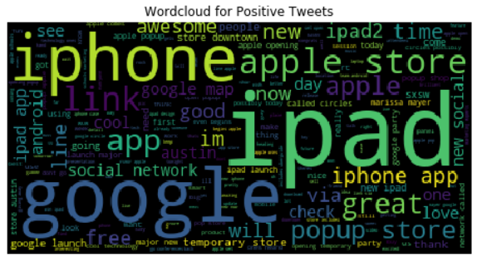
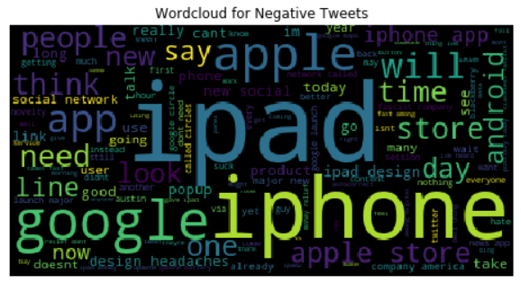
Wordclouds
As expected, the company and product names show up frequently
There are more positive words (i.e. great) in the positive tweets
The positive tweets seem to reference new products

Slide 5
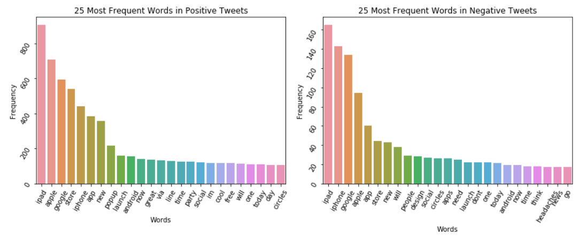
Most Common Words
Interestingly, need only appears as a top word for negative tweets
There are multiple references to new products (i.e. popup, party) in the positive tweets
Overall the words are fairly similar

Slide 6
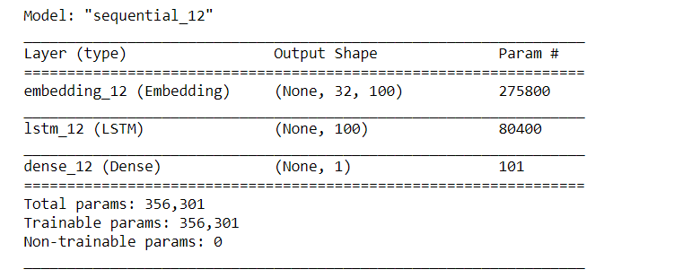
Modeling
Long Short Term Memory neural networks
This is a network that is able to remember but also able to throw away information it does not need
The best model was approximately 80% accurate

Slide 7
Recommendations
Having some kind of event around new products is related to positive tweets
Look out for words that are talking about taking an action because it is related to negative tweets
If you are looking for positive tweets about your product, the typical words like ‘great’ are in fact a big distinguisher between positive and negative tweets

Slide 8
Future Work
Collect more data
Add in neutral category
Get data from a wider time period

Slide 9
Summary
People tended to tweet more positively about the excitement of new products
Action words, i.e. will, are more common in negative tweets, perhaps indicating that people are tweeting about their intention to stop using a product
While the current model has fairly good accuracy, steps can be taken to improve the classification

Slide 10
Thank you!

